Slide 1
Long Range Planning –
District Maintenance Transportation and Safety Presentation
TEXARKANA ISD
May 19, 2022

Slide 2
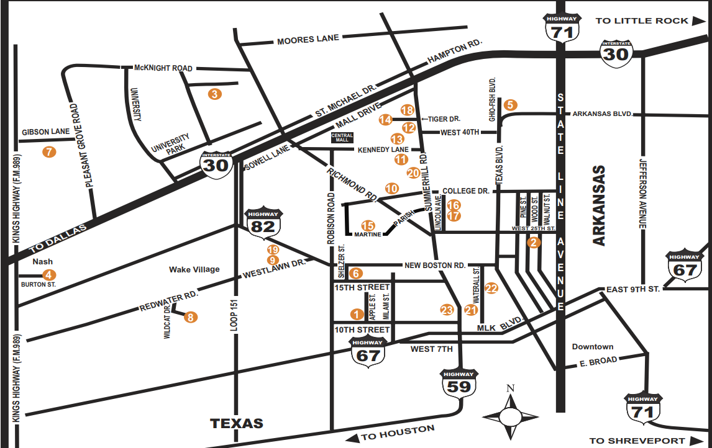
Overall District Maintenance and Transportation – All Facilities

Slide 3
Operations Departments:
Maintenance
Building Maintenance
Transportation
Food Service
Police Department
Risk Management
Events

Slide 4
Overall District Maintenance and Transportation – All Facilities
On Going Maintenance Program
TISD Maintenance is responsible for all work orders, repairs, cleaning, upkeep, preventive maintenance, etc. at all TISD facilities on an on-going basis.
This includes:
Interior and exterior painting
Door hardware, locks, etc.
Window replacement
Landscape, playgrounds, parking, drives, and site maintenance
Roofing repairs
HVAC repairs and ongoing upkeep
Electrical repairs and upkeep
Seasonal work such as filter changes, power washing, etc.
Daily cleaning of every campus as well as seasonal waxing, cleaning, etc.
Limited remodel (no permit required) such as moving a door or wall
Portable classroom coordination and upkeep
Emergency response

Slide 5
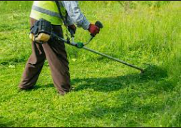
Overall District Maintenance and Transportation – All Facilities
Capital Maintenance Program
In addition, TISD Maintenance and Transportation maintains records and inventory of equipment
in the district for depreciating assets such as;
HVAC Equipment
Roofs
Owned Buses
Vehicles (“White Fleet” and other)
Equipment (mowers, trimmers, etc.)
These assets and their replacements are funded from either the yearly maintenance budget or the general fund, if other sources are not available.

Slide 6
Overall District Maintenance and Transportation – All Facilities
Capital Maintenance Program
ESSER funding (Elementary and Secondary School Emergency Relief – part of the Federal CARES Act of March 2021) has provided a one-time funding source that has allowed TISD Maintenance to address some long term deferred capital needs immediately.
HVAC Replacement- All Campuses
(3 Year Process).

Slide 7
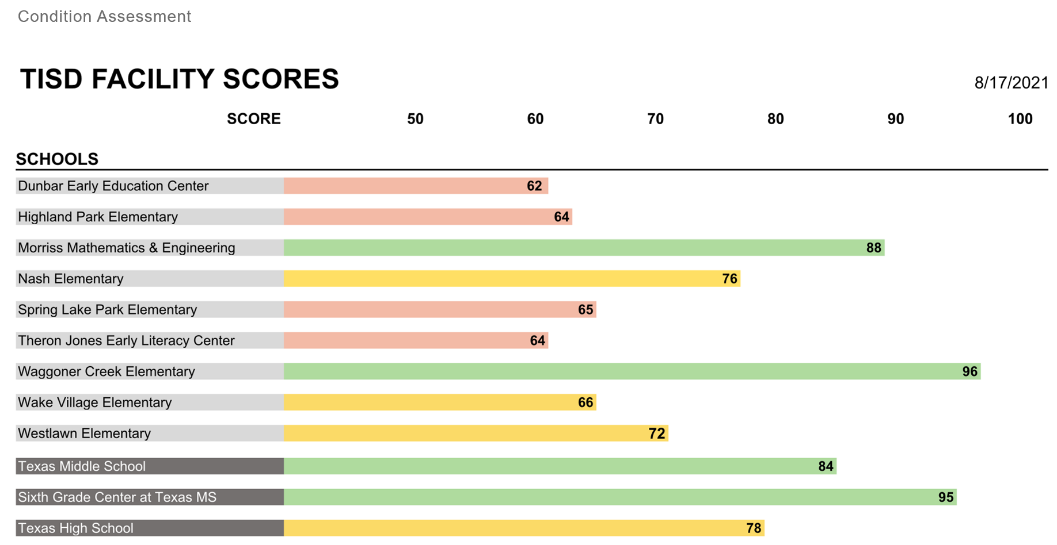
Overall District Maintenance and Transportation – All Facilities
Capital Maintenance Program
The use of the ESSER funds will address some of the HVAC equipment deficiencies noted in the assessment report.
Facility Assessment Scores
Additional Assessment Work

Slide 8
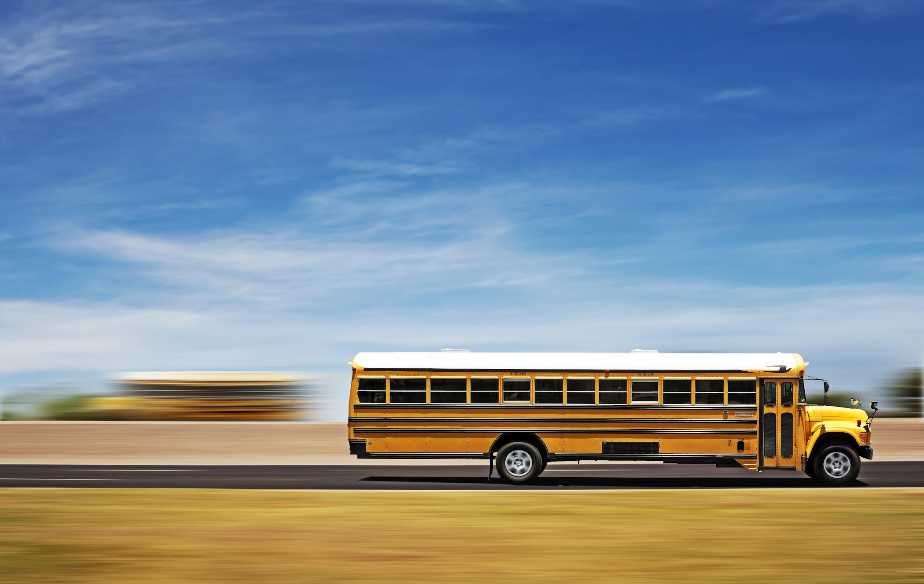
Overall District Maintenance and Transportation – All Facilities
Transportation Program
TISD currently participates in the Bowie County Transportation Co-op, which provides buses for the majority of our daily student transportation.
40 of the buses used in TISD are owned and maintained by Bowie County Co-op, which serves the following districts:
Texarkana ISD
LEISD
PGISD
Red Lick ISD
New Boston ISD
Redwater ISD
Maud ISD
Simms ISD
DeKalb ISD
Hubbard ISD

Slide 9
Overall District Maintenance and Transportation – All Facilities
Transportation Program
TISD owns and maintains 23 buses of its own, for purposes such as all Special Ed transportation, “trip” buses to and from games, events, etc., and in town shuttles between schools.
10 Buses Over 15 Years Old
8 Buses Over 20 Years Old
Buses last about 20 years
Current Replacement Program
18 buses are in need of replacement now or within the next few years.
Each bus costs approximately $150,000
Delivery Time (1 to 2 Years)

Slide 10
Overall District Maintenance and Transportation – All Facilities
Safety and Security Program – Access Control
TISD Maintenance is responsible for all locks, keys, and access control at all doors on all campuses.
All TISD employees carry keys
Lost Keys or Terminated Employees
Currently no way to track access of any door.
An access control system would allow card-reader or fob access to all controlled doors, and monitoring of all exterior doors.
Would allow ease of access for employees
Would enable tracking of entry, times, locations, etc.
Would facilitate “lock down” functions
Each card or fob can be programmed, turned off, and reset by central location

